Slide 1
azure

Slide 2
What is Azure ?
A cloud computing service created by Microsoft to build, develop, test, deploy and maintain applications is called Microsoft Azure.
Microsoft Azure, formerly known as Windows Azure, is Microsoft's public cloud computing platform. It provides a range of cloud services, including compute, analytics, storage and networking. Users can pick and choose from these services to develop and scale new applications, or run existing applications in the public cloud.

Slide 3
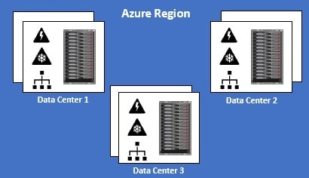
Azure Regions
An Azure Region is a set of Datacenters that are connected through a dedicated low-latency network.
There are regions of different sizes. A Region could be made up of just 1 datacenter or multiple datacenters.
The point is, an Azure Region is a group of one or more Azure Datacenters. As of this course recording, Azure has 58 regions worldwide.
You have the flexibility to deploy your applications and data to any Azure region you want. You can even deploy across multiple regions to deliver cross-region resiliency.

Slide 4
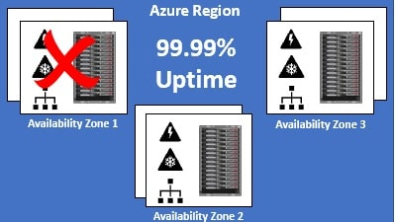
Availability zones
An Azure Availability Zone is a unique physical location within an Azure region. Each Availability Zone is made up of one or more datacenters with independent power, cooling, and networking. Not all Regions have Availability Zones. Regions that support Availability Zones have a minimum of three separate zones to ensure resiliency.
.
If one of the Availability Zones has gone down for some reason, we still have our applications and data available from the rest of the two Availability Zones. There is a physical separation between each Availability Zone and it is this separation that protects our applications and data from Datacenter failures. With Availability Zones, Azure offers industry best 99.99% VM uptime SLA.

Slide 5
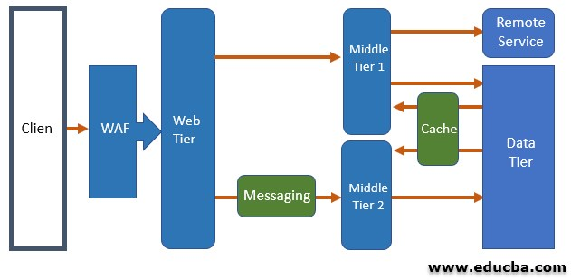
architecture
1. N-Tire Architecture
N-tier architecture is used in enterprise applications because it is a traditional architecture. The application is divided into layers, and each layer performs logical functions like logic used in business etc. and this way, the dependencies are managed. But there is one liability, that is the horizontal layer.
If we want to make changes in any one part of the application, we will have to make some changes in the other part of the application too. Hence there are challenges of updates frequently, and new features cannot be added easily. If we would like to migrate the existing applications, which is based on the architecture that is layered, then N-tier architecture is a good fit.

Slide 6
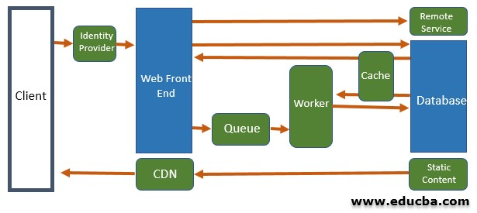
2. Web queue worker
The application using this style of architecture consists of a front end to handle the HTTP requests and a back end to perform operations that are CPU intensive.
An asynchronous message queue is used for communication between the front end and the back end. This style of architecture is suitable for simple tasks that are based on resources.
Deployment and operations are simplified by using managed services. But it is difficult to manage the dependencies if the domains are complex. With complex domains, the maintenance and update for the front end and backend become difficult.

Slide 7
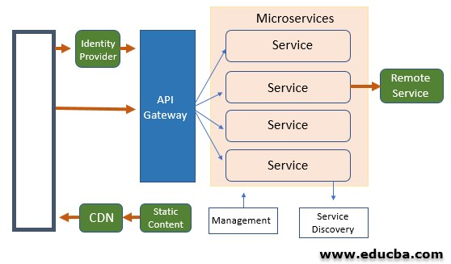
3. Microservices architecture
A lot of small yet independent services constitute microservices architecture. Single business capacity is implemented by each service. The services communicate through contracts of API, and they are coupled loosely. A focused development team can build a service.
Coordination among the teams is necessary to build individual services, and frequent updates are encouraged. Microservice architecture building is complex when compares to other architectures like N-tier and web queue worker.
Good development and culture of devops are necessary to build a microservices architecture. But if the microservices architecture is built in the right manner, this architectural style results in higher velocity and quicker innovation.

Slide 8
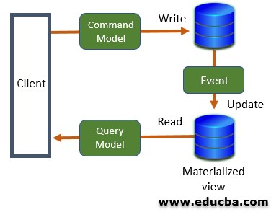
4. Command and query responsibility segregation
The operations of reading and writing are segregated into two different models by Command and Query Responsibility Segregation Architecture.
The part of the system that writes the data or updates the data is separated by the part of the system that reads the data. Also, the write operation is performed on a separate database, and the read operation is performed against a materialized view.
This helps in performing the read and write operations independently, and the materialized view can be optimized for queries. The Command and Query Responsibility Segregation Architecture make a good subset of some larger architecture because when it is applied to an application, the entire architecture becomes complex.
When the same data is to access by any number of users, Command and Query Responsibility Segregation Architecture can be considered for collaborative domains.

Slide 9
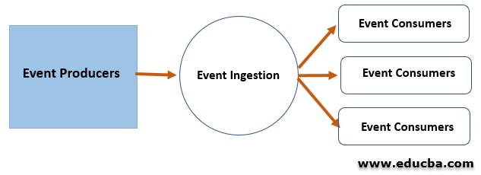
5. Event driven architecture
Event-driven architecture follows a publish-subscribe model, which is also called the pub-sub model. In this model, events are published by producers, and they are subscribed by the consumers.
The producers and consumers are independent of each other, and the consumers are independent of each other.
This architecture is also useful when there is the same event data, and different subsystems are performing different sorts of processing on this same event data.

Slide 10
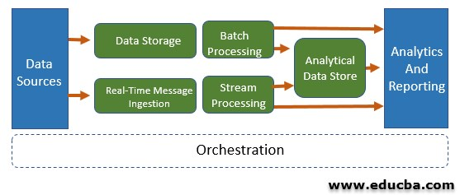
6. Big data, big compute architecture
Some profiles fit only particular types of architectures, and one such architecture is big data, big compute architecture, which is one of the special architectures for fitting profiles of certain types.
A very huge dataset is divided into chunks by Big data for processing the data in parallel and for reporting and analysis. Big compute is also called high-performance computing (HPC), is used to perform computations in parallel for thousands or a greater number of cores.

Slide 11
Azure virtual machines
Azure Virtual Machines (VM) is one of several types of on-demand, scalable computing resources that Azure offers. Typically, you choose a VM when you need more control over the computing environment than the other choices offer.
Why use Azure virtual networks ?
Azure virtual network enables Azure resources to securely communicate with each other, the internet, and on-premises networks. Key scenarios that you can accomplish with a virtual network include - communication of Azure resources with the internet, communication between Azure resources, communication with on-premises resources, filtering network traffic, routing network traffic, and integration with Azure services.

Slide 12
Azure virtual networks
Azure Virtual Network (VNet) is the fundamental building block for your private network in Azure. VNet enables many types of Azure resources, such as Azure Virtual Machines (VM), to securely communicate with each other, the internet, and on-premises networks. VNet is similar to a traditional network that you'd operate in your own data center, but brings with it additional benefits of Azure's infrastructure such as scale, availability, and isolation.

Slide 13
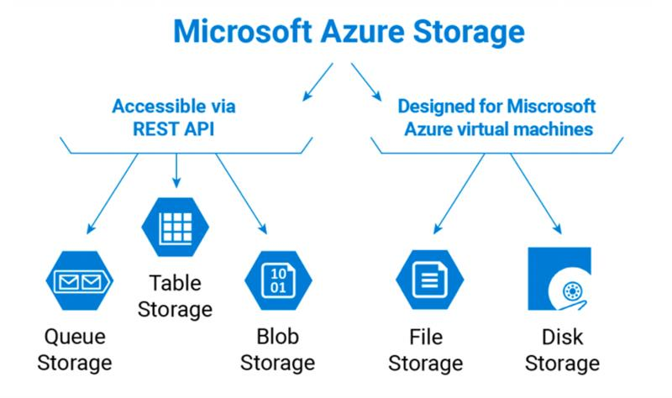
Azure storage account
An Azure storage account contains all of your Azure Storage data objects, including blobs, file shares, queues, tables, and disks. The storage account provides a unique namespace for your Azure Storage data that's accessible from anywhere in the world over HTTP or HTTPS.

Slide 14
Database service
Azure SQL Database is a fully managed database service, which means that Microsoft operates SQL Server for you, and ensures its availability and performance. SQL Database also includes innovative features to enhance your business continuity, such as built-in high availability.

Slide 15
Core solutions in azure
Azure Internet-of-Things – Azure IoT Central, Azure IoT Hub, Azure Sphere
Azure Big Data and Analytics – Azure SQL Data Warehouse, Azure HDInsight, Azure Data Lake Analytics, Azure Data Databricks.
Azure Artificial Intelligence – Azure Machine Learning Services, Azure Machine Learning Studio, Cognitive Services, Azure Bot Services.
Serverless Computing – Azure Functions, Azure Logic Apps, Azure Event Grid.

Slide 16
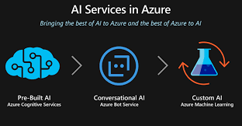
AI services
These services include: Azure cognitive services, including a variety services related to language and language processing (speech recognition, speech formation, translations), text recognition, and image and character recognition. The services can be used, for example, in various bot-based solutions.

Slide 17
Azure iot
The Azure Internet of Things (IoT) is a collection of Microsoft-managed cloud services that connect, monitor, and control billions of IoT assets. In simpler terms, an IoT solution is made up of one or more IoT devices that communicate with one or more back-end services hosted in the cloud. It also includes security and operating systems for devices and equipment, along with data and analytics that help businesses to build, deploy and manage IoT applications.
we consider how these services work together across three components:
Things: The physical objects or things, such as industrial equipment, devices or sensors, that connect to the cloud persistently or intermittently.
Insights: Information collected by the things, which is analysed and turned into actionable knowledge either by people or AI.
Actions: The way people respond to those insights and connect them to their business, as well as the systems and tools they use.

Slide 18
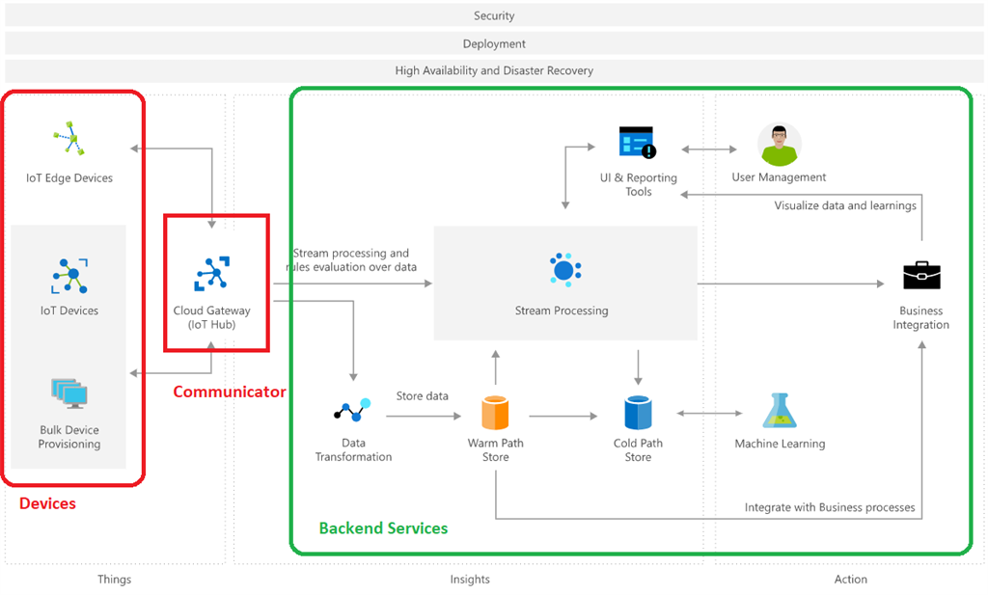

Slide 19
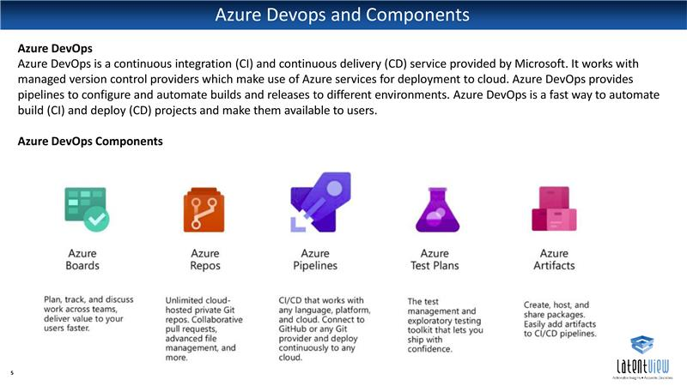
Azure devops

Slide 20
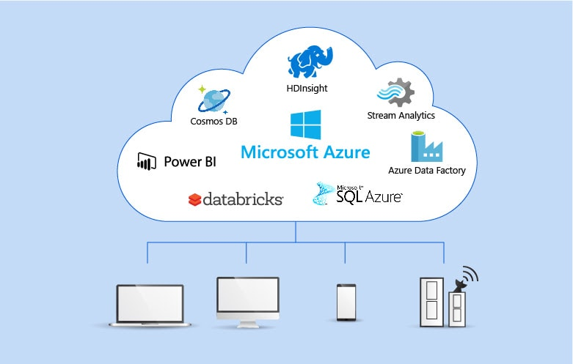
Azure big data and analytics
Big data analytics is the use of advanced analytic techniques against very large, diverse data sets that include structured, semi-structured, and unstructured data, from different sources, and in different sizes from terabytes to zettabytes.
Azure SQL Data Warehouse – A cloud-based Enterprise Data Warehouse.
Azure HDInsight – A fully managed, open-source analytics service for enterprises.
Azure Data Lake Analytics – An on-demand analytics job service that simplifies big data.
Azure Data Databricks – An Apache Spark-based analytics platform optimized for the Microsoft Azure cloud services platform.

